Slide 1


An In-depth Analysis of Airline Customer Satisfaction
Hector Enriquez , Ifa Afariogun

Slide 2




Table of contents
01
02
03
Context & EDA
Data Pre-Processing & Logistic Regression/ Decision Tree
Conclusion & Recommendations

Slide 3
Executive Summary
Business Problem
Improve customer satisfaction for Invistico Airline by identifying the key factors that influence satisfaction and predicting whether a prospective customer will be satisfied with their service.
Task
Forecast if a prospective customer will be satisfied and identify service aspects to prioritize for better satisfaction.
Notes:
Invistico is an alias for this specific airline’s data for security purposes.

Slide 4



01
Context & EDA
The dataset focuses on customer satisfaction and travel behaviors for an airline. It includes key features such as customer satisfaction levels, travel types, customer loyalty, seat comfort, food and drink ratings, and flight distances.
The goal is to identify patterns and insights that can help improve customer experience and satisfaction.

Slide 5
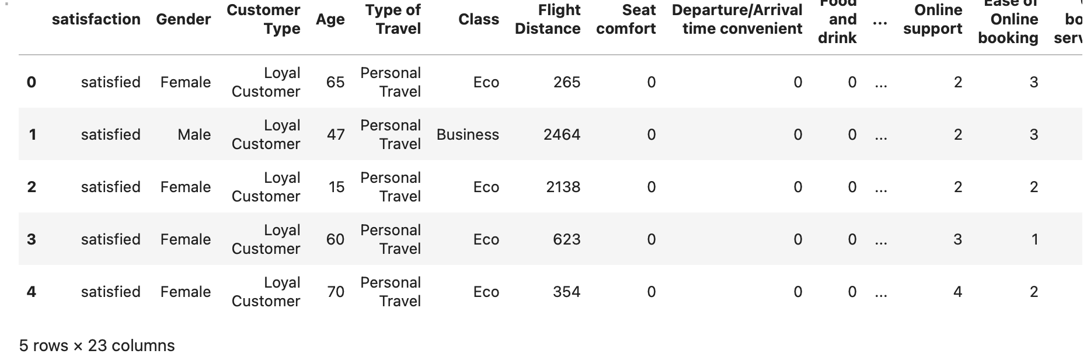
Initial Observation of Customer Satisfaction for Invistico Airlines
What is in this data set?
Customer details, flight information, and feedback from passengers who have previously flown with Invistico.
Dataset contains 129,880 rows and 23 columns. Captures passenger attributes including: satisfaction levels, gender, age, flight details, and seat comfort.

Slide 6
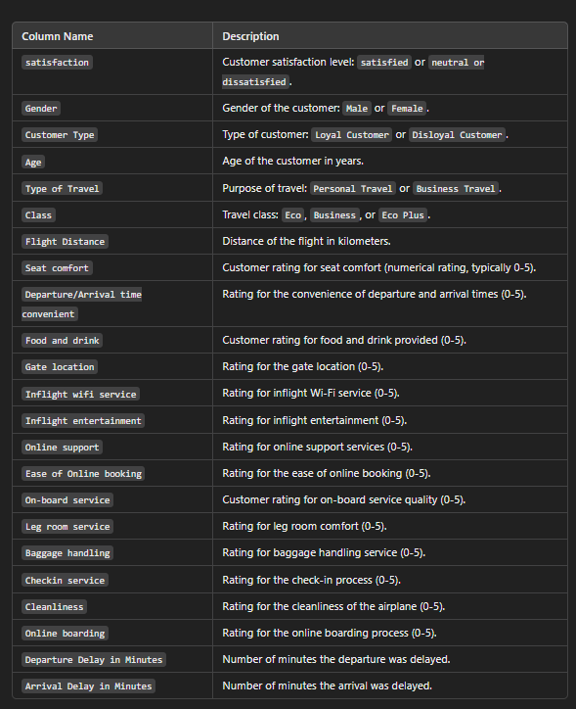
Data Dictionary

Slide 7
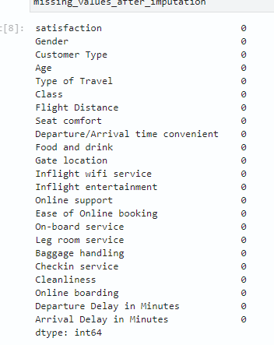
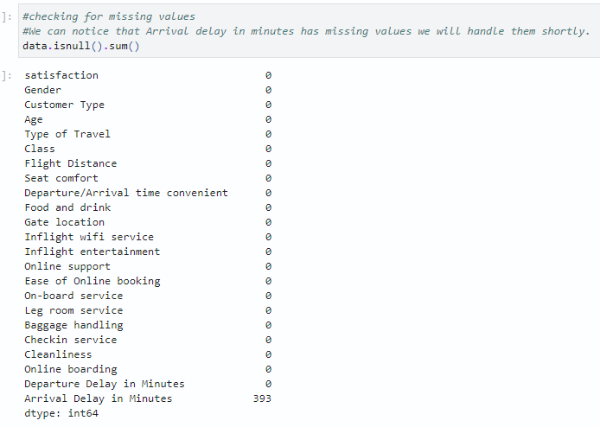
Addressing Missing Values

Slide 8
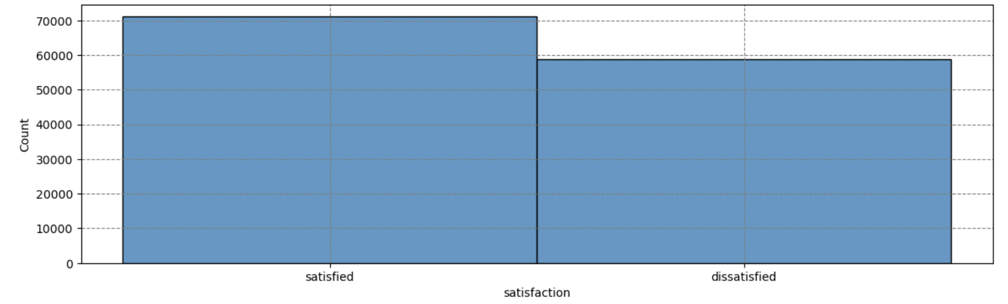
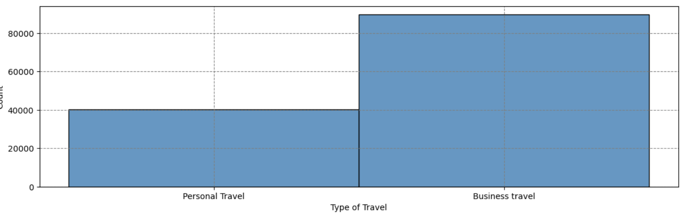
Exploratory Data Analysis
Approach: Univariate Analysis provided clearer insights into each feature after differentiating and separating the data.

Slide 9
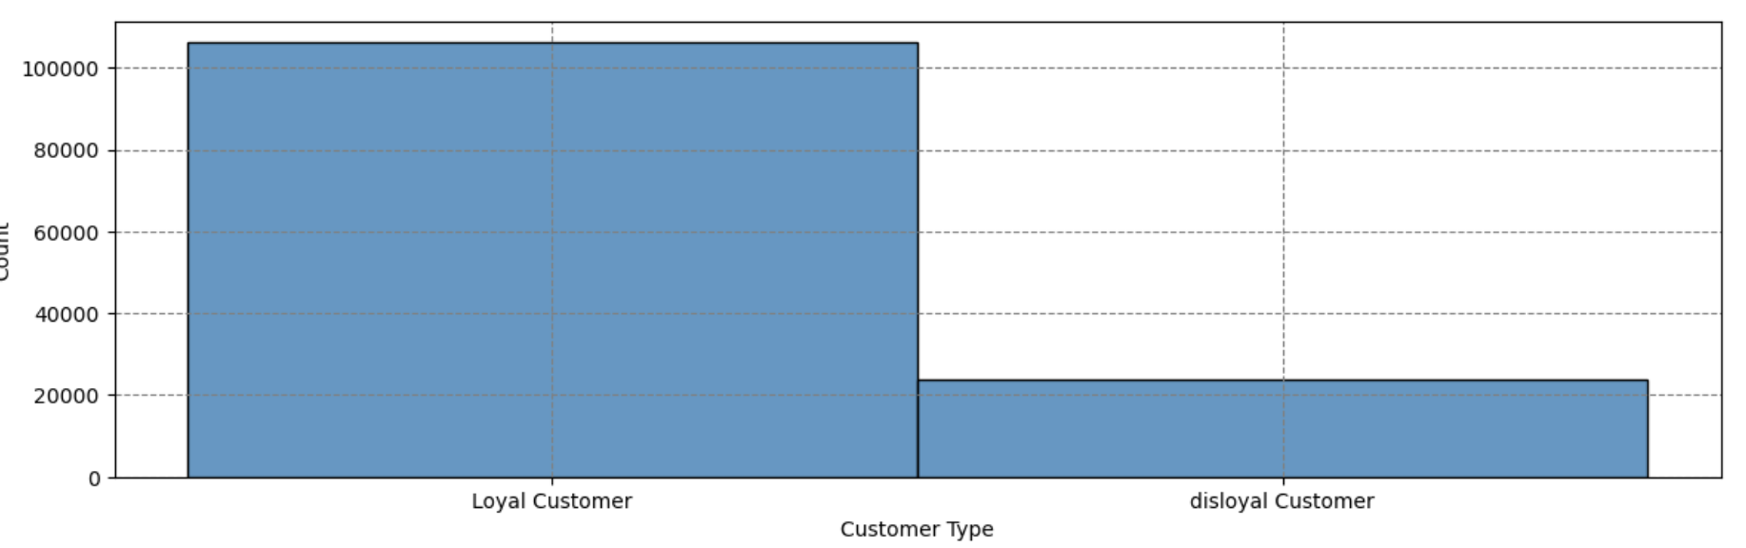
Exploratory Data Analysis cont.
Bar Chart Findings: Airline has ~50/50 satisfaction and dissatisfaction rate.
Majority of passengers are loyal customers.
Most passengers are traveling for business purposes.

Slide 10
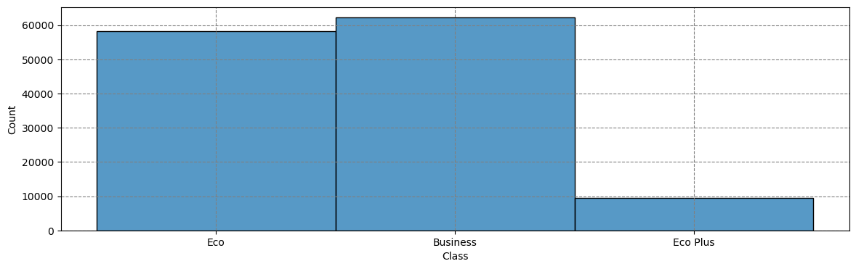
Exploratory Data Analysis cont.
Bar Chart Findings: Airline has ~50/50 satisfaction and dissatisfaction rate.
Majority of passengers are loyal customers.
Most passengers are traveling for business purposes.

Slide 11
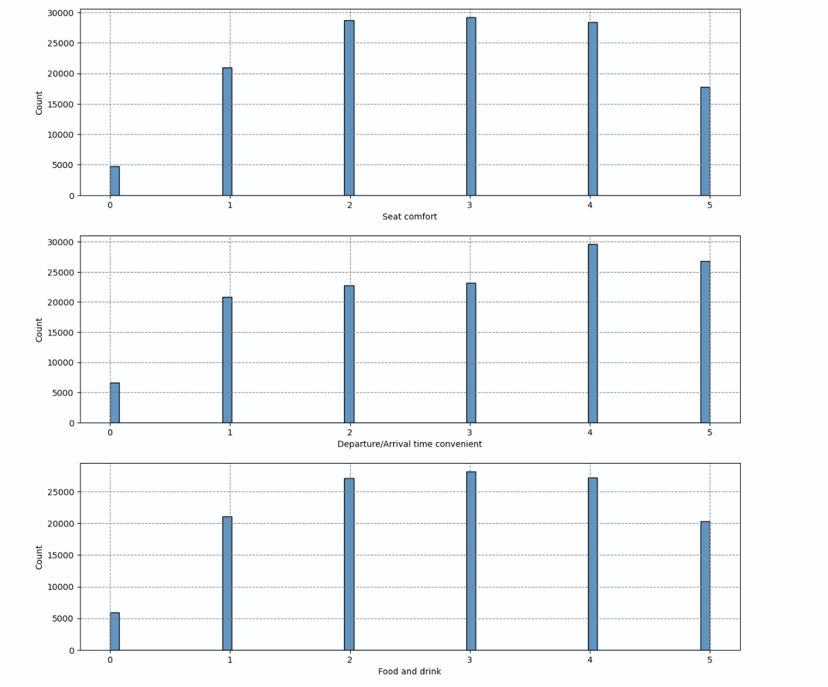
Exploratory Data Analysis cont.
Satisfaction levels relative to seat comfort, departure/arrival time, and food & drink.

Slide 12
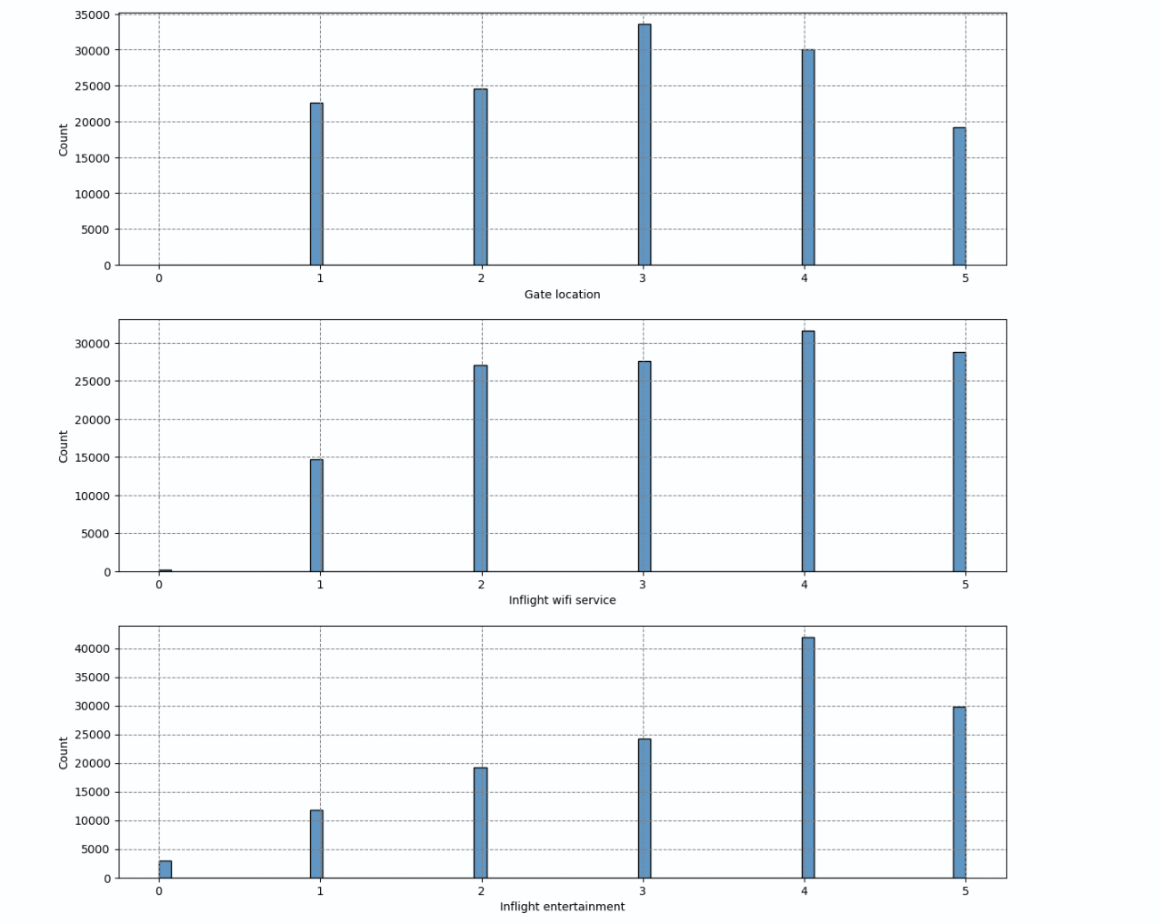
Exploratory Data Analysis cont.
Satisfaction levels relative to gate location, inflight wifi service, and inflight entertainment.

Slide 13
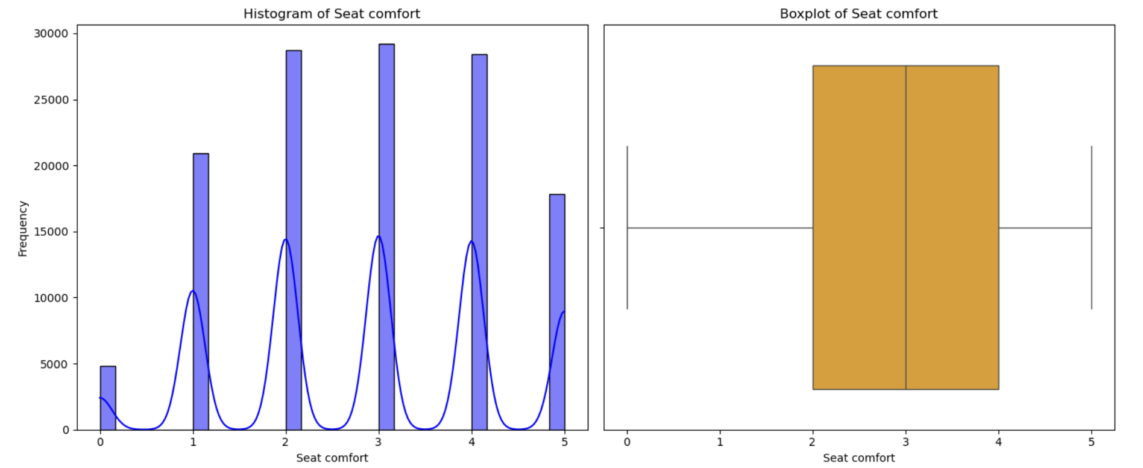
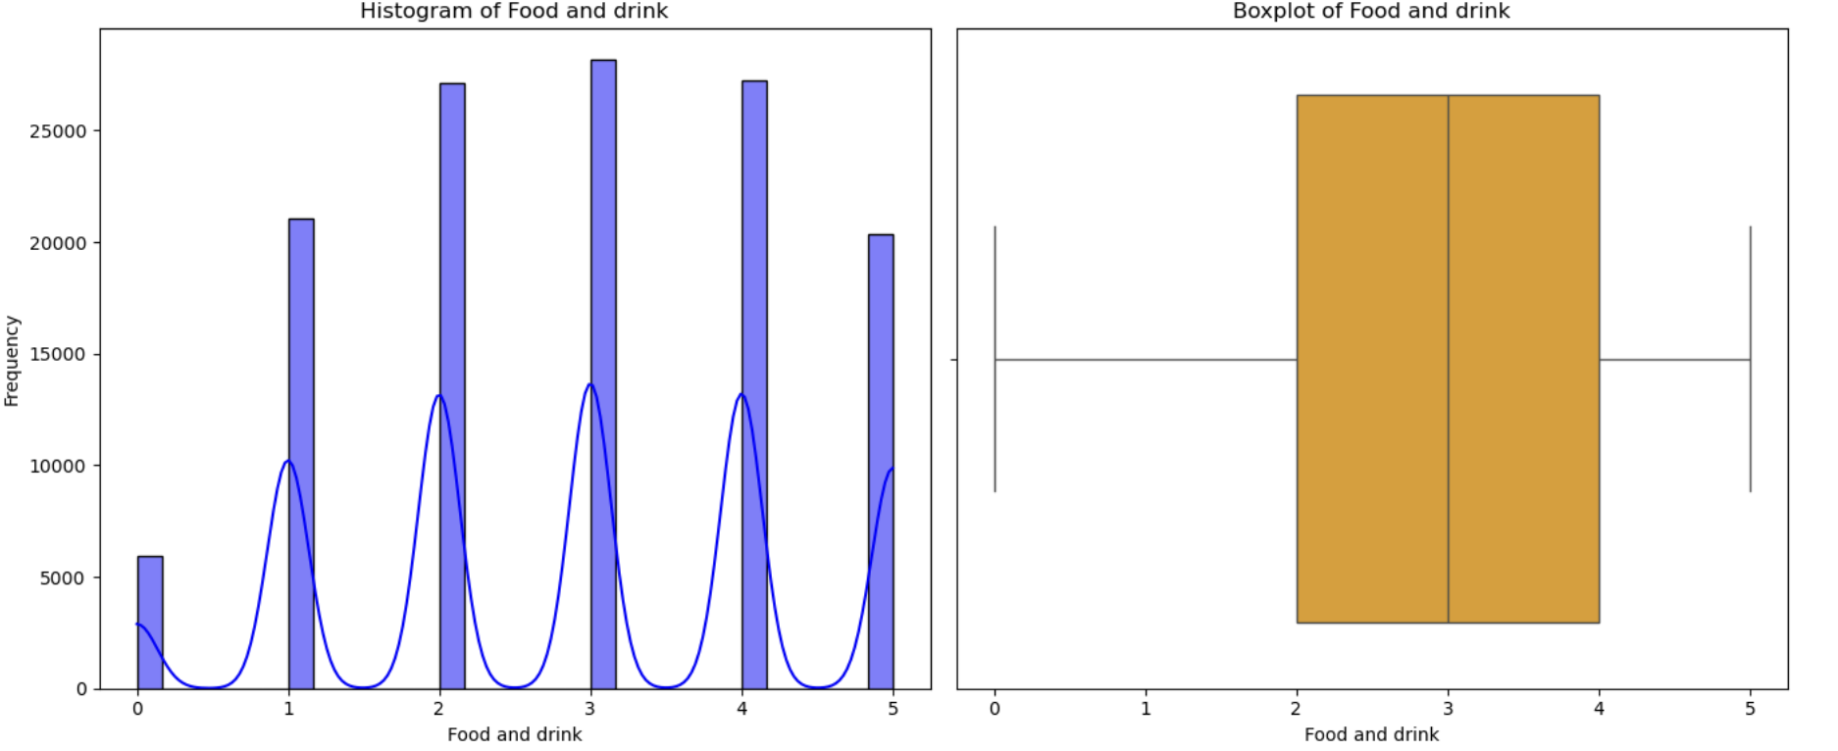
Histogram and Boxplot Findings:
Ratings for seat comfort, and food and drink generally meet or exceed expectations (scores 3 - 5).

Slide 14
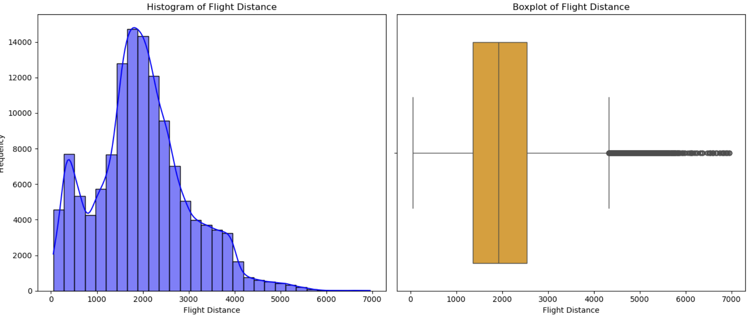
The distances traveled on these flights were not far: Shorter flights have simpler amenities and less room for error.
What could this mean?
Shorter flights may have a higher satisfaction rate than longer flights.

Slide 15
Insights from Univariate Analysis
Numerical Variables
Age:
Majority of passengers aged 20–50, indicating working-age frequent flyers.
Symmetric distribution suggests no significant demographic bias.
Flight Distance:
Right-skewed distribution; most flights are regional or medium-haul (1,000–3,000 units).
Long-haul passengers may require enhanced amenities (e.g., meals, entertainment).
Seat Comfort, Food, and Drink Ratings:
Scores cluster around 3–5, reflecting moderate to high satisfaction.
Low ratings (0 or 1) identify dissatisfaction areas for improvement.
Departure/Arrival Delays:
Most flights have minor delays (0–50 minutes); extreme delays are rare but impactful.
Delays critically affect satisfaction; operational issues need attention.

Slide 16
Insights from Univariate Analysis
Categorical Variables
Gender:
Near-equal male/female distribution; opportunity to tailor services based on satisfaction differences.
Customer Type:
Loyal customers dominate; focus on improving retention by meeting higher expectations.
Type of Travel:
Business travel is prevalent; prioritize timeliness, inflight productivity, and comfort for business flyers.
Class of Travel:
Economy and Business classes are most common; satisfaction may vary by class.
Address pain points specific to Economy or Economy Plus passengers.
4o

Slide 17
01
Bivariate Analysis
Due to the fact that our target variable is binary we conducted stacked bar plots and boxplots that show the mean of the continuous variable across the two categories of target variable.

Slide 18
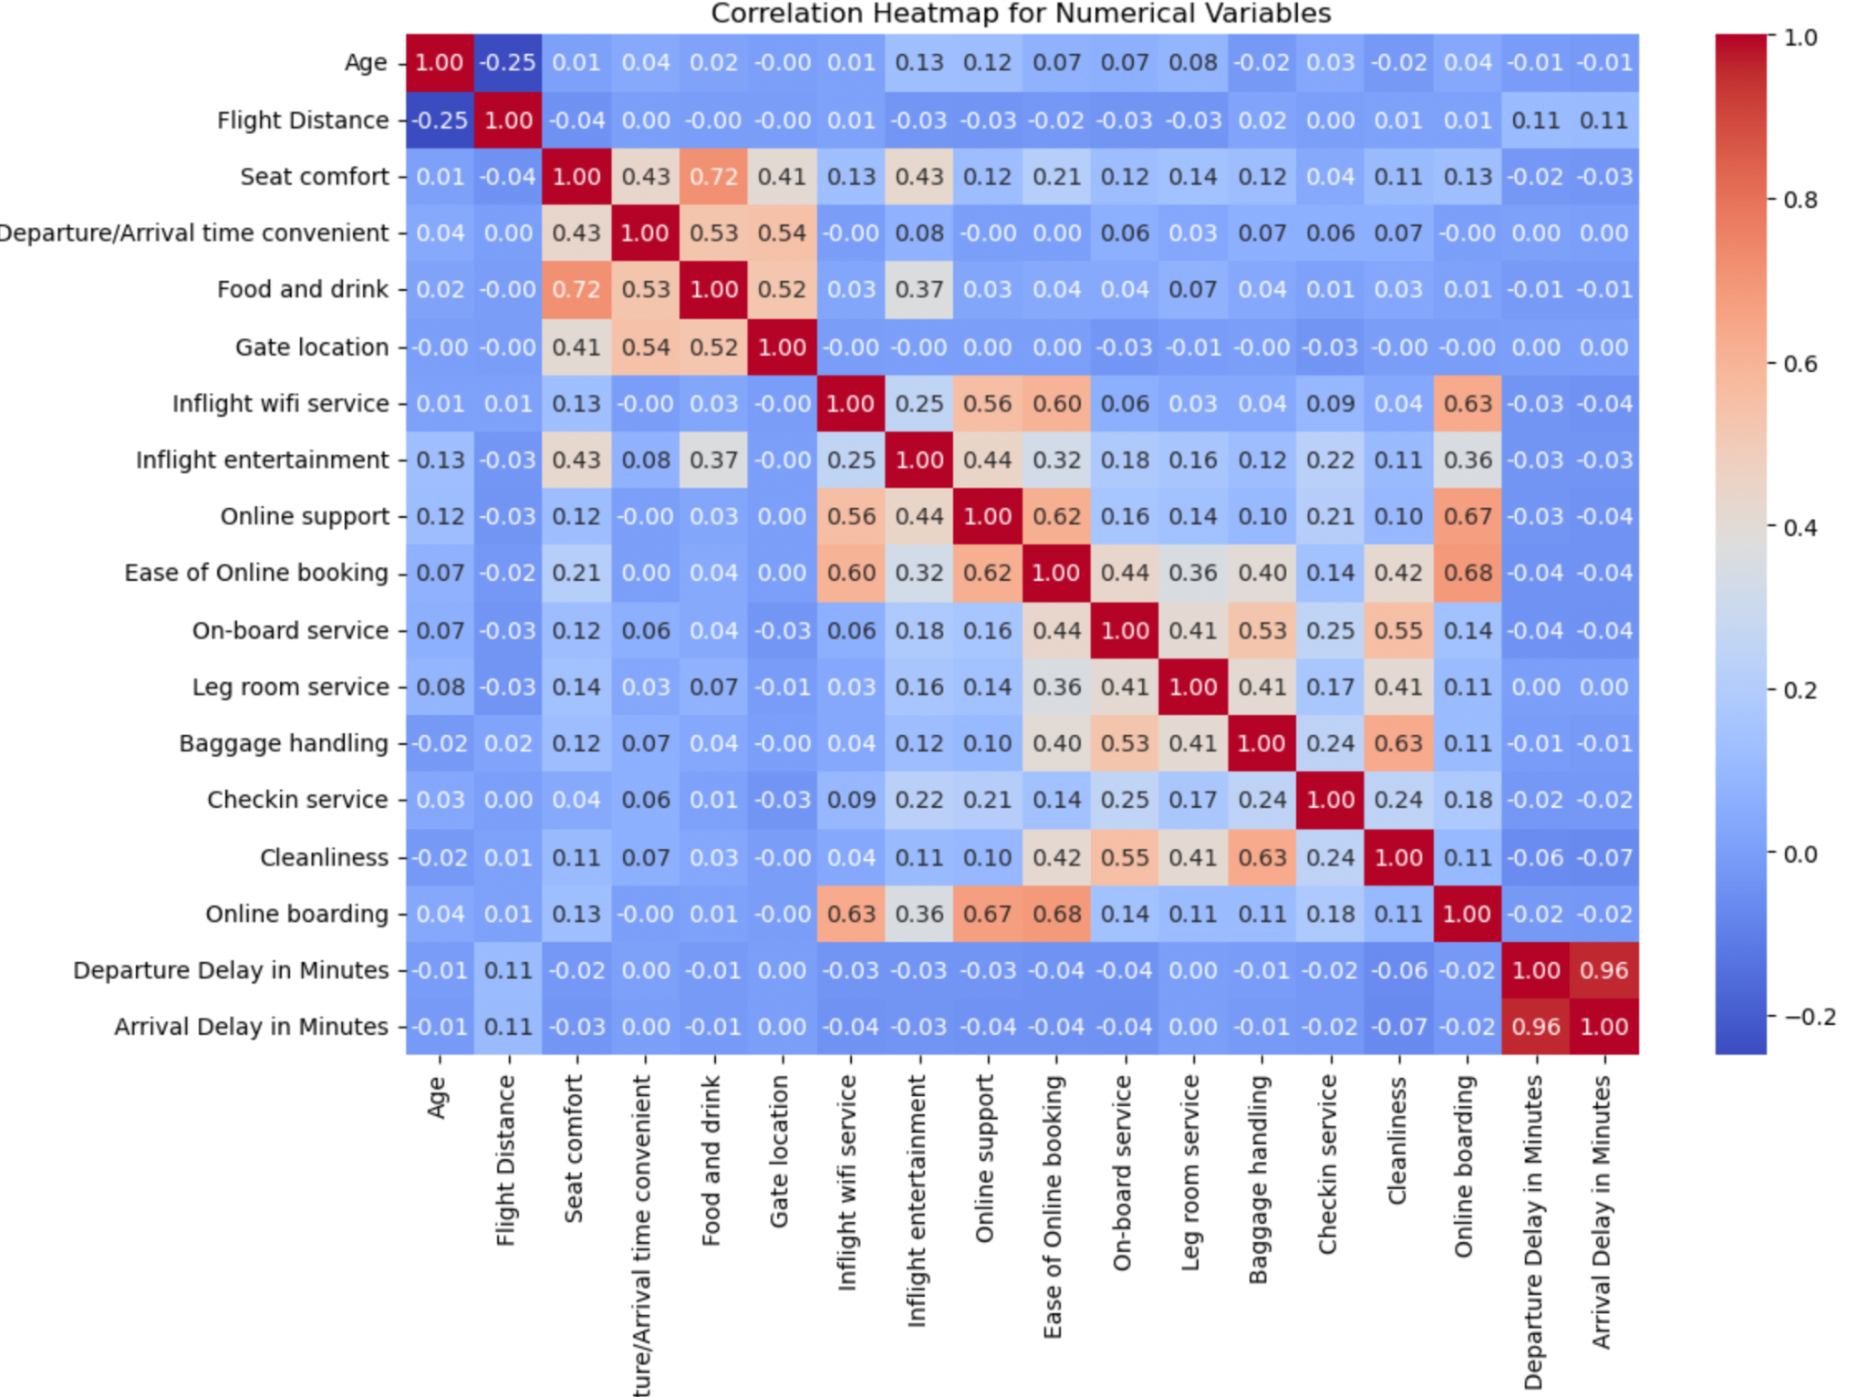
Heatmap
Correlations:
Ease of online booking and boarding (0.68): Related to satisfaction with boarding
Seat comfort, Food/Drink, Entertainment (0.4-0.7): Moderate relationships with in-flight satisfaction.
Departure/Arrival Time Convenience: Moderately correlated with gate location.

Slide 19
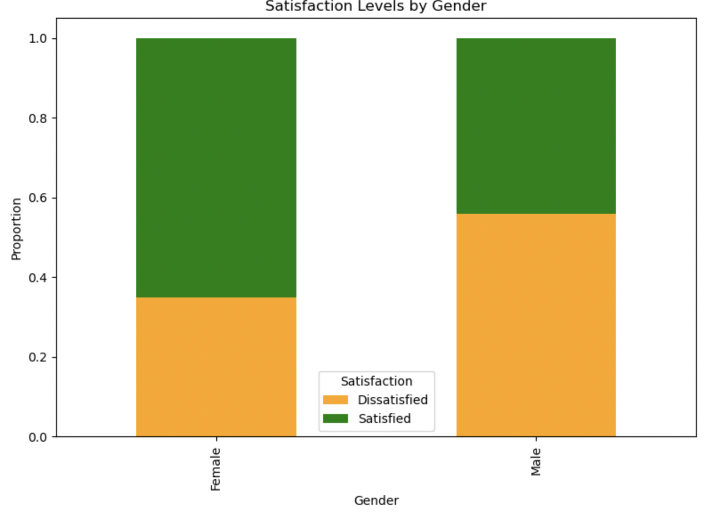
Satisfaction Levels by Gender
Male passengers were more dissatisfied than female passengers.

Slide 20
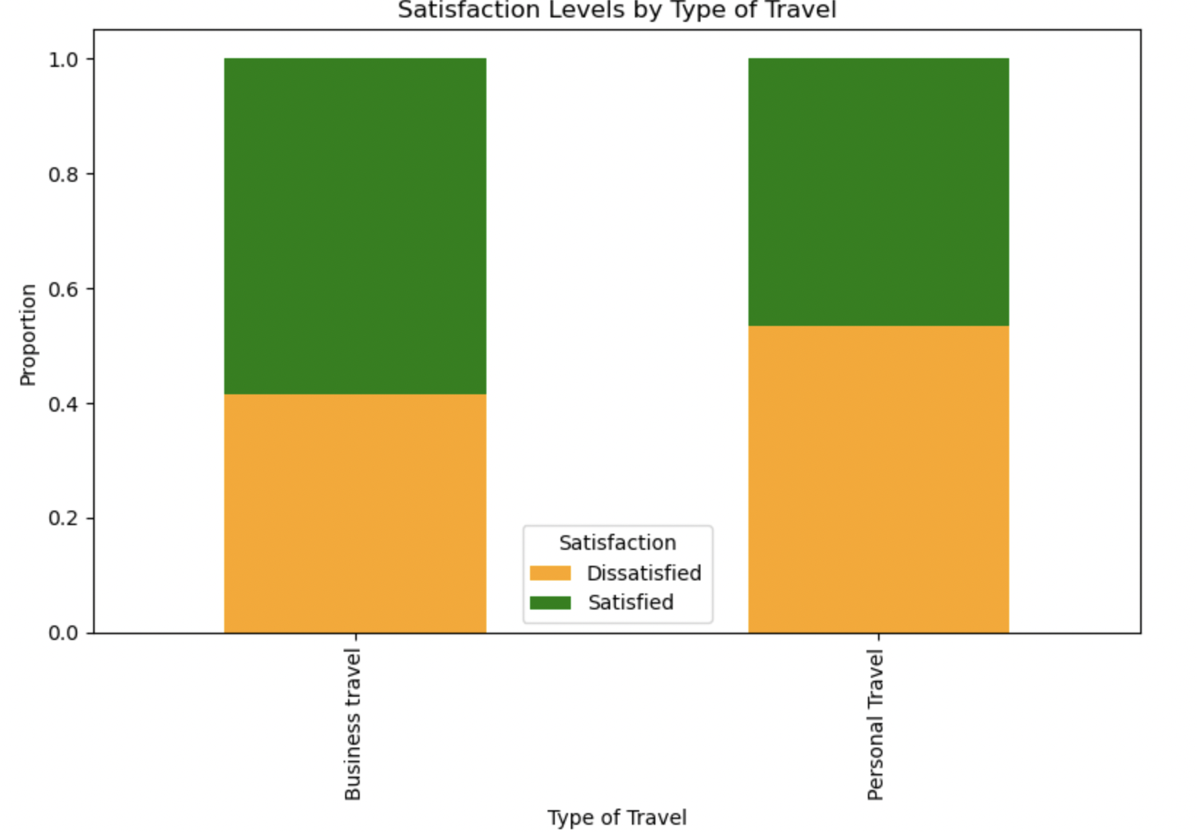
Satisfaction Levels by Type of Travel
Business travelers were more satisfied than personal travelers.

Slide 21
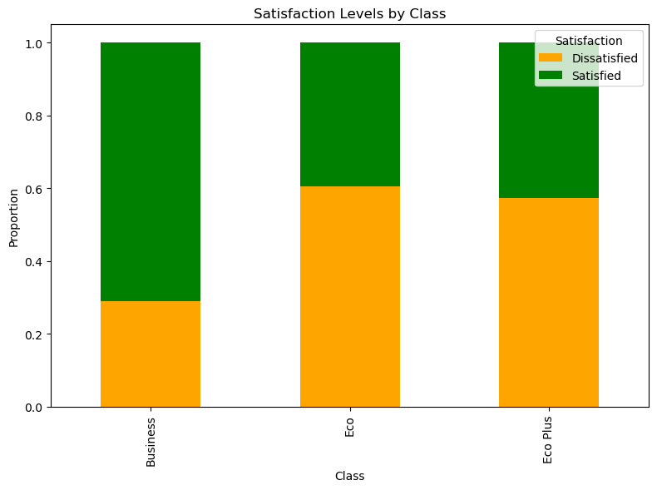
Satisfaction Levels by Class
Business Class passengers have the highest satisfaction proportion.
Economy and Eco Plus classes exhibit more dissatisfaction.
Insight: Service improvements (e.g., comfort, inflight experience) in Economy classes could address dissatisfaction.

Slide 22
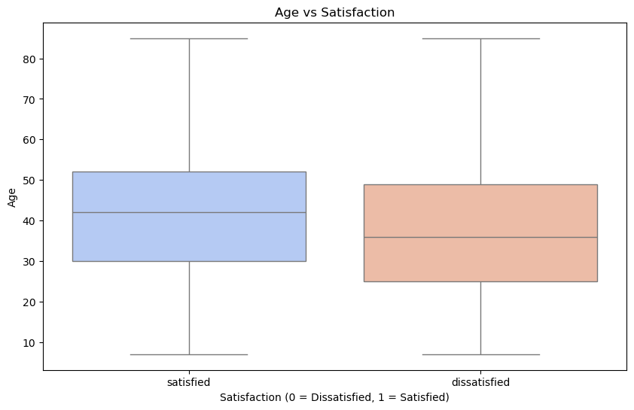
Relationship of Age with Satisfaction
Satisfied customers tend to have a slightly higher median age.
Younger passengers have more spread in dissatisfaction, suggesting differences in expectations for service.

Slide 23
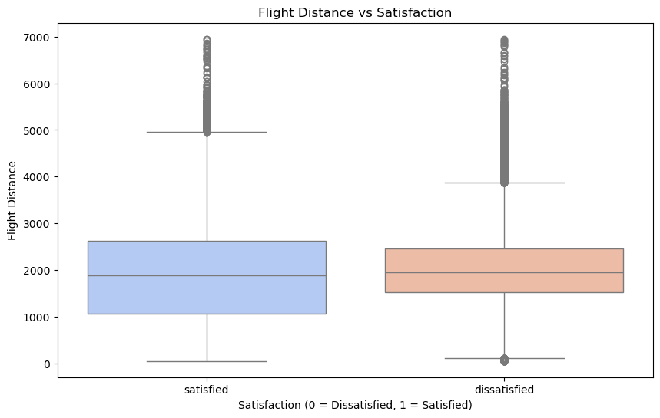
Relationship of Flight Distance with Satisfaction
Satisfied customers typically travel longer distances.
Dissatisfaction is more common for shorter flights, potentially due to fewer amenities or services.

Slide 24

Insights from Bivariate Analysis
Higher ratings for seat comfort, legroom, onboard service, and inflight wifi/entertainment strongly correlate with satisfied customers.
Dissatisfaction stems from consistently poor ratings across these service areas.
Longer flight distances are associated with higher satisfaction.
Shorter flights see more dissatisfaction, possibly due to limited amenities.
Satisfied customers have a slightly higher median age.
Younger passengers show greater dissatisfaction spread, highlighting potential unmet expectations.

Slide 25

Insights from Bivariate Analysis
Delays (departure and arrival) do not significantly differentiate satisfaction.
Extreme delays (outliers) occur in both satisfied and dissatisfied groups
Food, cleanliness, gate location, and check-in services receive higher ratings from satisfied customers.
Dissatisfaction aligns with consistently lower ratings in these areas.

Slide 26

At A Glance Recommendations
Inflight Services: Focus on seat comfort, food, and entertainment, especially for short flights.
Delays: Reduce departure and arrival delays to boost satisfaction.
Short Flights: Add comfort upgrades for short-distance travelers.
Young Flyers: Enhance entertainment for younger customers.
Loyalty: Strengthen loyalty programs to retain satisfied customers.
Cleanliness & Check-In: Prioritize cleanliness and streamline check-in processes.

Slide 27
02
Data Preparation & Creation of Models

Slide 28
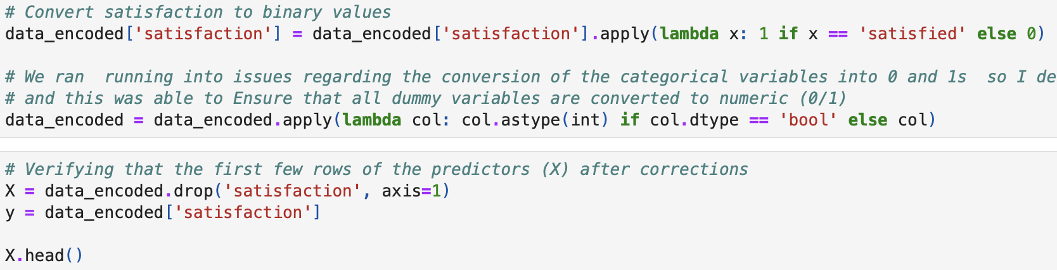
Logistic Regression
Approach: Logistic Regression model can predict customer satisfaction (target variable:satisfaction)
Categorical variables (“Gender,” “Customer Type,” etc.) are transformed into dummy variables.
Dataset is divided into training and testing sets, with the stratify parameter to ensure the target variable (satisfaction) is equal in both groups.
Evaluation Metrics: Accuracy, Recall, Precision, and F1 score analyzed. Confusion matrix used for visualizing true/false positives and negatives.

Slide 29
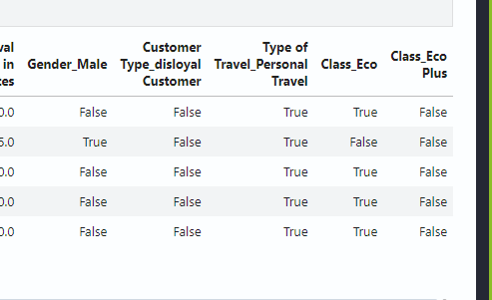
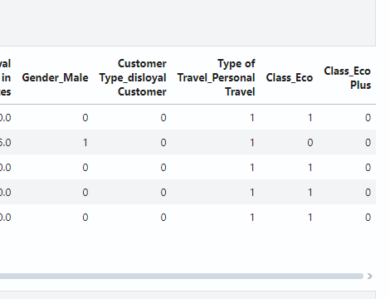

Slide 30
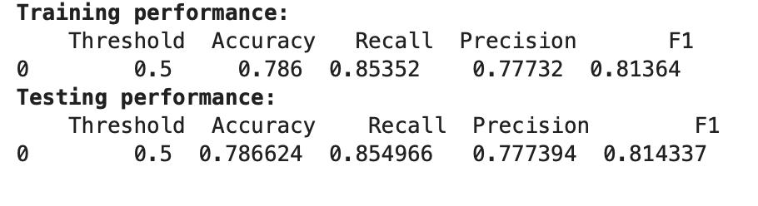
Observations
Training Results
Accuracy: 78.6%
Recall: 85.3%
Precision: 77.7%
F1 Score: 81.4%
These high numbers indicate the logistic regression mode’s strong performance in predicting passenger satisfaction.
Testing Results
Accuracy: 78.6%
Recall: 85.4%
Precision: 77.7%
F1 Score: 81.4%
Consistent performance, with slight increase to recall.
Model is not overfitting.

Slide 31
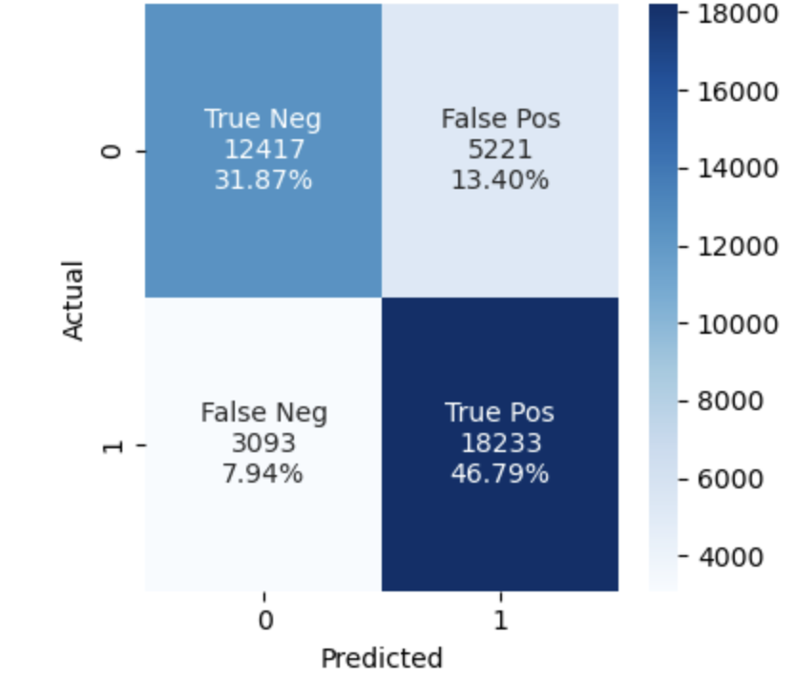
Confusion Matrix
True Positives: 46.79% Correctly classified satisfied passengers.
True Negatives:31.87% Correctly classified dissatisfied passengers.
False Positives: 13.40% Dissatisfied passengers misclassified as satisfied.
False Negatives:7.94% Satisfied customers misclassified as dissatisfied.

Slide 32
Establishing Ground Rules & Understanding What do We Need Out of our Model
High False Positives pose a significant business risk, as they might conceal underlying service issues.
Reducing False Positives is crucial to ensure dissatisfied customers are identified and targeted for improvement efforts.

Slide 33
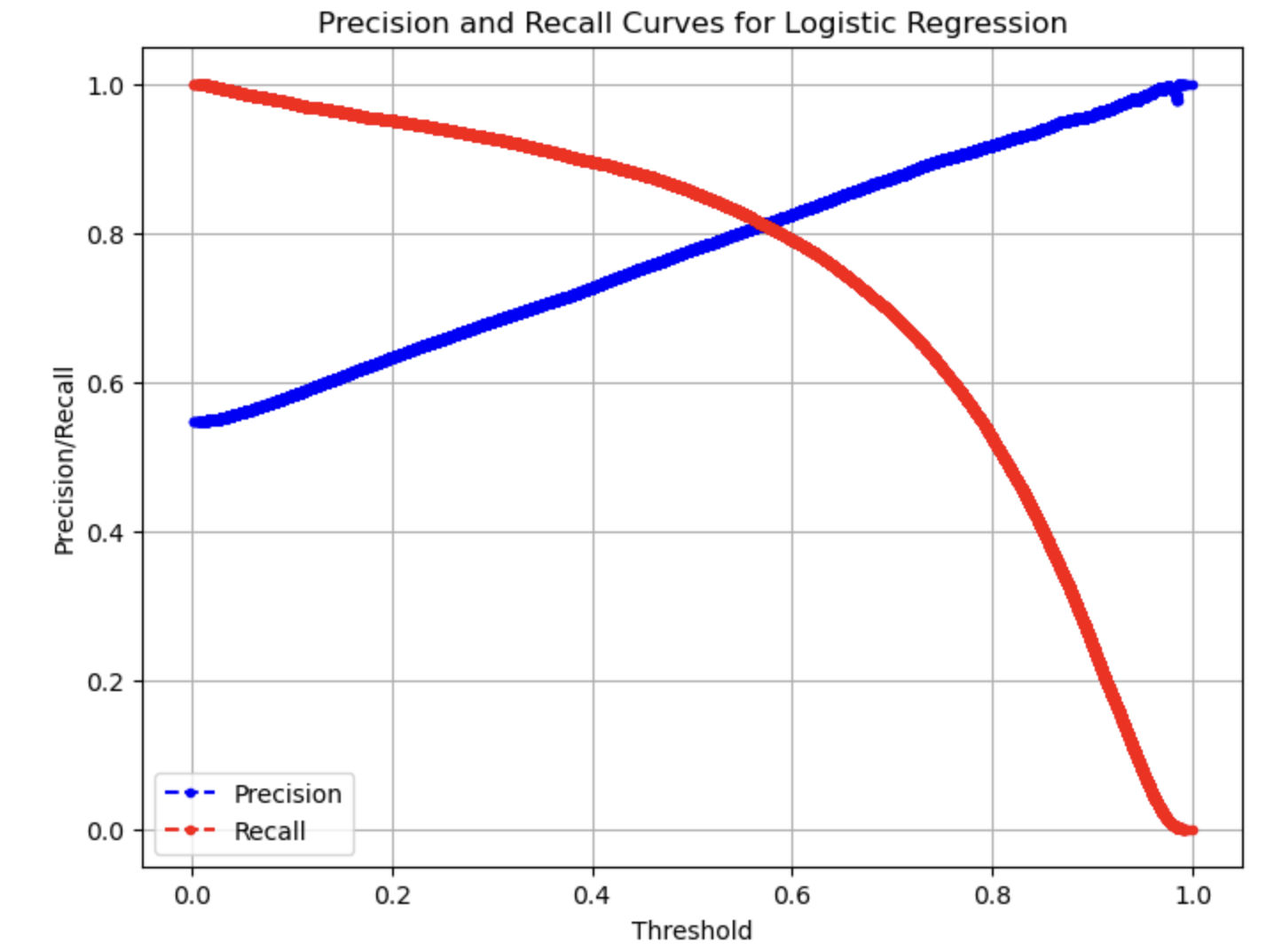
Tuning Model
Precision (Blue Curve): Increases as the threshold rises, leading to fewer false positives.
Recall (Red Curve):Decreases as the threshold rises, risking missed satisfied customers.
The Trade-Off
Lower Thresholds: High recall but more false positives.
Higher Thresholds: High precision but lower recall.
Optimal Threshold should be 0.6-0.7 to balance both.

Slide 34
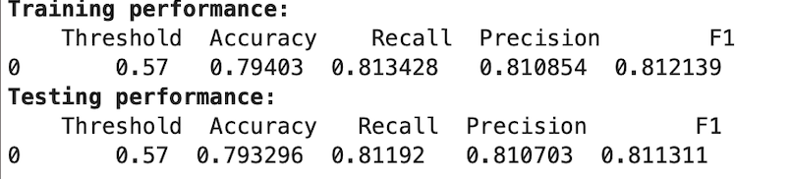
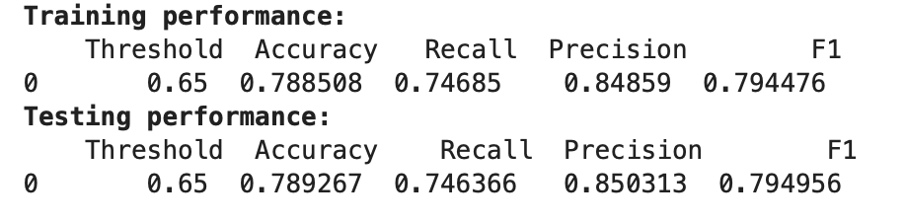
Comparing Thresholds
Chosen Threshold: 0.65
Precision: 85%. Meets goal of reducing false positives.
Recall: 74.6%. Still accurately categorizes a majority of satisfied customers.
Business Impact:
In a customer satisfaction model, it is typically more important to avoid False Positives than to maximize recall.
Dissatisfied customers mistakenly classified as satisfied can harm the airline's ability to:
Identify and address operational or service-related problems.

Slide 35
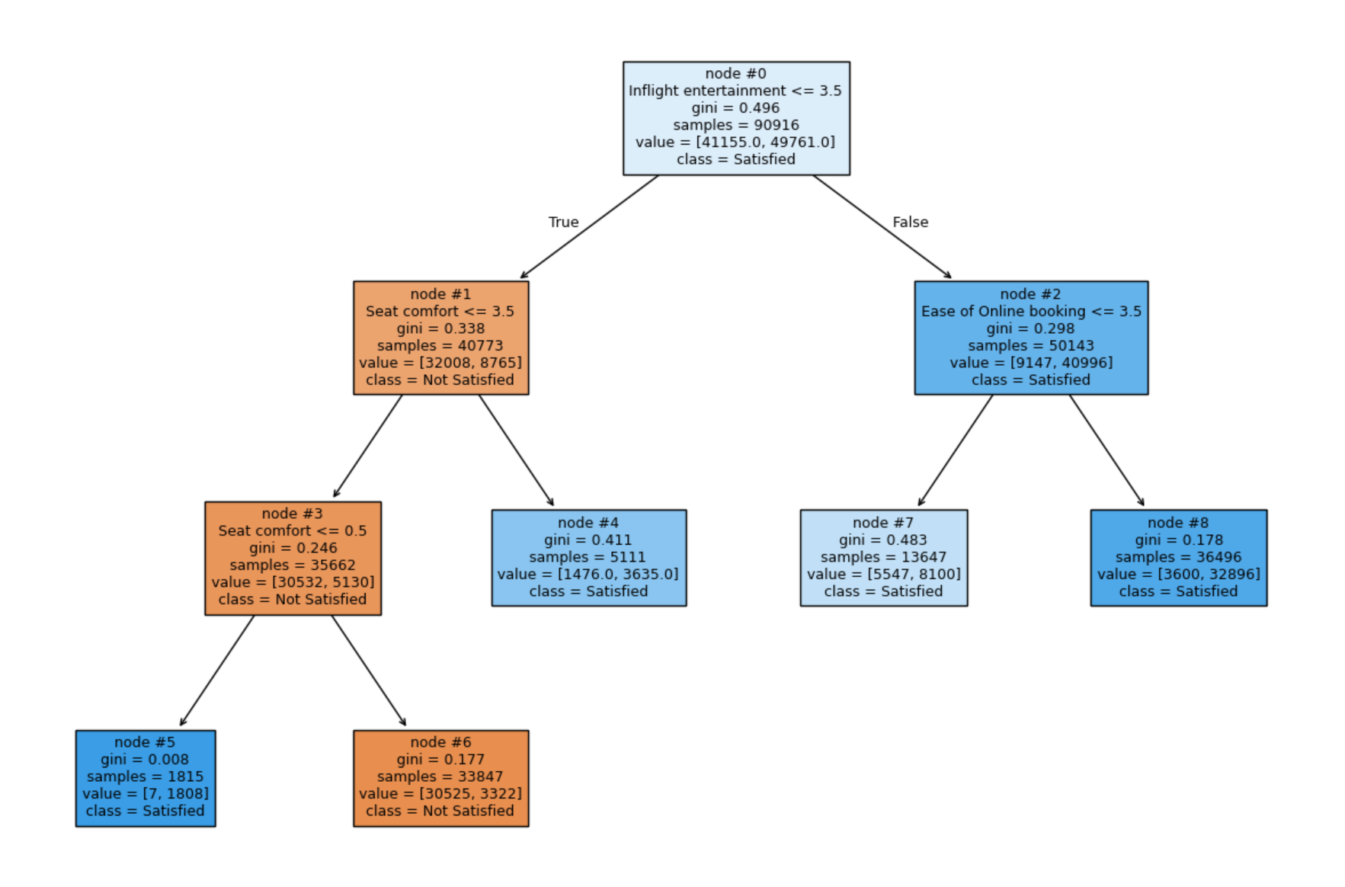
Decision Tree

Slide 36
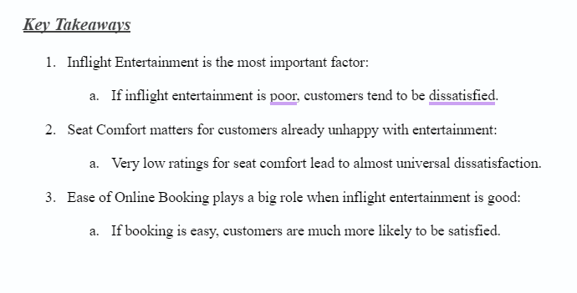

Slide 37
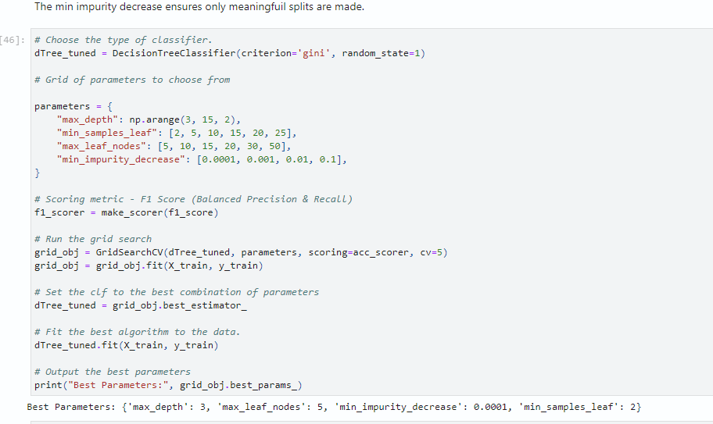

Slide 38



Model Comparison
Decision Tree Model
Precision: 85.03%
Recall: 74.63%
Accuracy: 78.9%
F1-Score: 79.5%
Strengths:
Identifies clear patterns and relationships.
Offers actionable insights with a structured decision-making process.
Logistic Regression
Precision: 85.03%
Recall: 74.63%
Accuracy: 78.9%
F1-Score: 79.5%
Strengths:
Simplicity and interpretability make it ideal for communicating insights to stakeholders.
Threshold tuning allowed us to prioritize precision and reduce False Positives (key focus).

Slide 39


Final Model Recommendations
Higher Precision: which ensures we are correctly identifying dissatisfied customers
Additionally its visual interpretability offers clear, actionable rules for business decision-making.

Slide 40
Conclusion & Recommendations
04

Slide 41



General Recommendations
1. Prioritize improvements in inflight entertainment, seat comfort, and online booking.
2. Implement real-time feedback systems for quick issue resolution.
3. Customize services for different customer segments (e.g., business vs. leisure travelers).
4. Use predictive analytics to optimize resources and reduce false satisfaction predictions.

Slide 42
Specific Recommendations
1. Inflight Entertainment: Upgrade systems with personalized content and better options.
2. Seat Comfort: Improve seating ergonomics and introduce premium options.
3. Business Travelers: Offer premium packages with priority seating, lounge access, and better meals.
4. Ease of Booking: Simplify the process via user-friendly apps and one-click rebooking.
5. Customer Loyalty: Launch rewards programs and address dissatisfaction with compensations.

Slide 43
Resources
Data Source:
https://www.kaggle.com/code/iamsouravbanerjee/shopping-trends-unveiled-eda-for-beginners
Other Resources:
https://www.ibm.com/topics/exploratory-data-analysis
https://www.geeksforgeeks.org/what-is-exploratory-data-analysis/

Slide 44


Thank you!

